Slide 1
A Trusted, Decentralized Marketplace for Cloud Computing
Anthony Simonet-Boulogne, PhD Research Scientist, iExec Blockchain Tech
INSA, Lyon Oct. 21st 2021

Slide 2
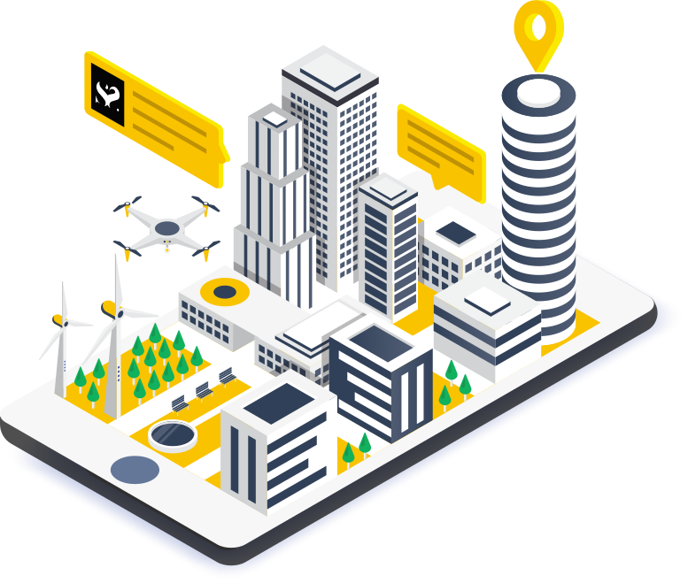
What we do
iExec provides an open and decentralized cloud computing marketplace.
Connects providers with users: anyone can trade computing power, datasets, and applications.
No need to trust iExec or anyone else: just trust the blockchain and the code.
2

Slide 3
Blockchain & Decentralisation
A decentralised, immutable and verifiable digital ledger consisting of transaction records distributed across many computers.
Decentralised
Immutable
Verifiable
A blockchain executes programs and records transactions with no single point of control, and no single point of failure.
A blockchain is append-only: each block records a new state, but any change in a previous block will break the chain.
Because a blockchain keeps a record of all the changes since its Genesis Block, it is always possible to check how we got to the current state.
3
Notes:
En fait ça arrive, de temps en temps ; mais cela ne nous inquiète pas particulièrement parce que le secteur bancaire est très régulé et surveillé. Par contre, le même principe peut s’appliquer à tout un tas d’autres secteurs…

Slide 4
Blockchain & Decentralisation
A decentralised, immutable and verifiable digital ledger consisting of transaction records distributed across many computers.
Decentralised
Immutable
Verifiable

Slide 5
Smart contracts?
Self-executing and self-enforcing programs that can read and write the state of a blockchain.
Transparent
Auditable
Autonomous
Hard to program
Limited in size
Often extremely critical
Cannot access external data
contract Coin {
address public minter;
mapping (address => uint) public balances;
function Coin() public {
minter = msg.sender;
}
function mint(address receiver, uint amount) public {
if (msg.sender != minter) return;
balances[receiver] += amount;
}
function send(address receiver, uint amount) public {
if (balances[msg.sender] < amount) return;
balances[msg.sender] -= amount;
balances[receiver] += amount;
}
}
5

Slide 6
Blockchains
What they are
A way for arbitrary people and organisations to collaborate without having to trust anyone.
A tool for transparency and democracy.
A platform for deploying unstoppable programs.
What they’re not
Fast
Cheap
Easy to program
User friendly
But we’re working on it ;-)
6

Slide 7
iExec history
Founded in 2016 by Gilles Fedak (Inria) & Haiwu He (Chinese Academy of Sciences)
April 2017: ICO raised 10,000 Bitcoins within 3 hours
Based in Lyon
Background
ICO: 2017/4
V1: 2017/11
V2: 2018/5
V3: 2019/5
V4: 2019/12
V5: 2020/7
V6: 2021/7
15 years
in cloud computing
& HPC
87M RLC issued
10k BTC raised
Off-chain computing SDK, Dapp Store, Dapp Challenge
Marketplace
Data Store
Data Renting
−
Lightweight workers
−
Mainnet
GPU
−
BoT
−
Sidechain
Interoperability
−
DeFi
−
Confidential Computing
French SEC
approval
-
Regulated marketplace
7

Slide 8
A not so new idea...
We described a computational model based upon the classic science-fiction film, The Blob: a program that started out running in one machine, but as its appetite for computing cycles grew, it could reach out, find unused machines, and grow to encompass those resources. In the middle of the night, such a program could mobilize hundreds of machines in one building; in the morning, as users reclaimed their machines, the “blob” would have to retreat in an orderly manner, gathering up the intermediate results of its computation. (This affinity for night-time exploration led one researcher to describe these as “vampire programs.”)
(John F. Shoch and Jon A. Hupp, 1982)
8
Notes:
The idea of Desktop Grid computing that is using idle PCs on the Internet to execute very large computation is not new.
distributed computing in the sense of making a super computer out of spare machines. For instance, I was able to find a paper from 1982 that descibes this model.
Cosmognoia the origin of every idea should be at the Palo Alto, Rank Xerox lab.

Slide 9

iExec allows individuals and enterprises to monetize their computing power, applications and datasets.
Computing power
Applications
Datasets
9

Slide 10

Why decentralise the cloud?
Centralized Computing
Unfair pricing
Vendor lock-in
Limited transparency
Limited accountability
No provenance information
Possible censorship
Decentralised Cloud Computing
Market-based prices
Fair competition between providers
Smooth business agreements
Complete execution history on the blockchain
Unstoppable marketplace: censorship is impossible
10

Slide 11




iExec overview
Data
owners
Application providers
Cloud providers
financial flow
dataset
application
server
$
$
$
emit order
Requester
(users)
Blockchain-based decentralized
iExec Marketplace
Access control
Data
renting
Confidential Computing
Pay-per-
Task
$
request / buy
Monetize App
Automatic payments
Trading
Autonomous
app
<numéro>

Slide 12
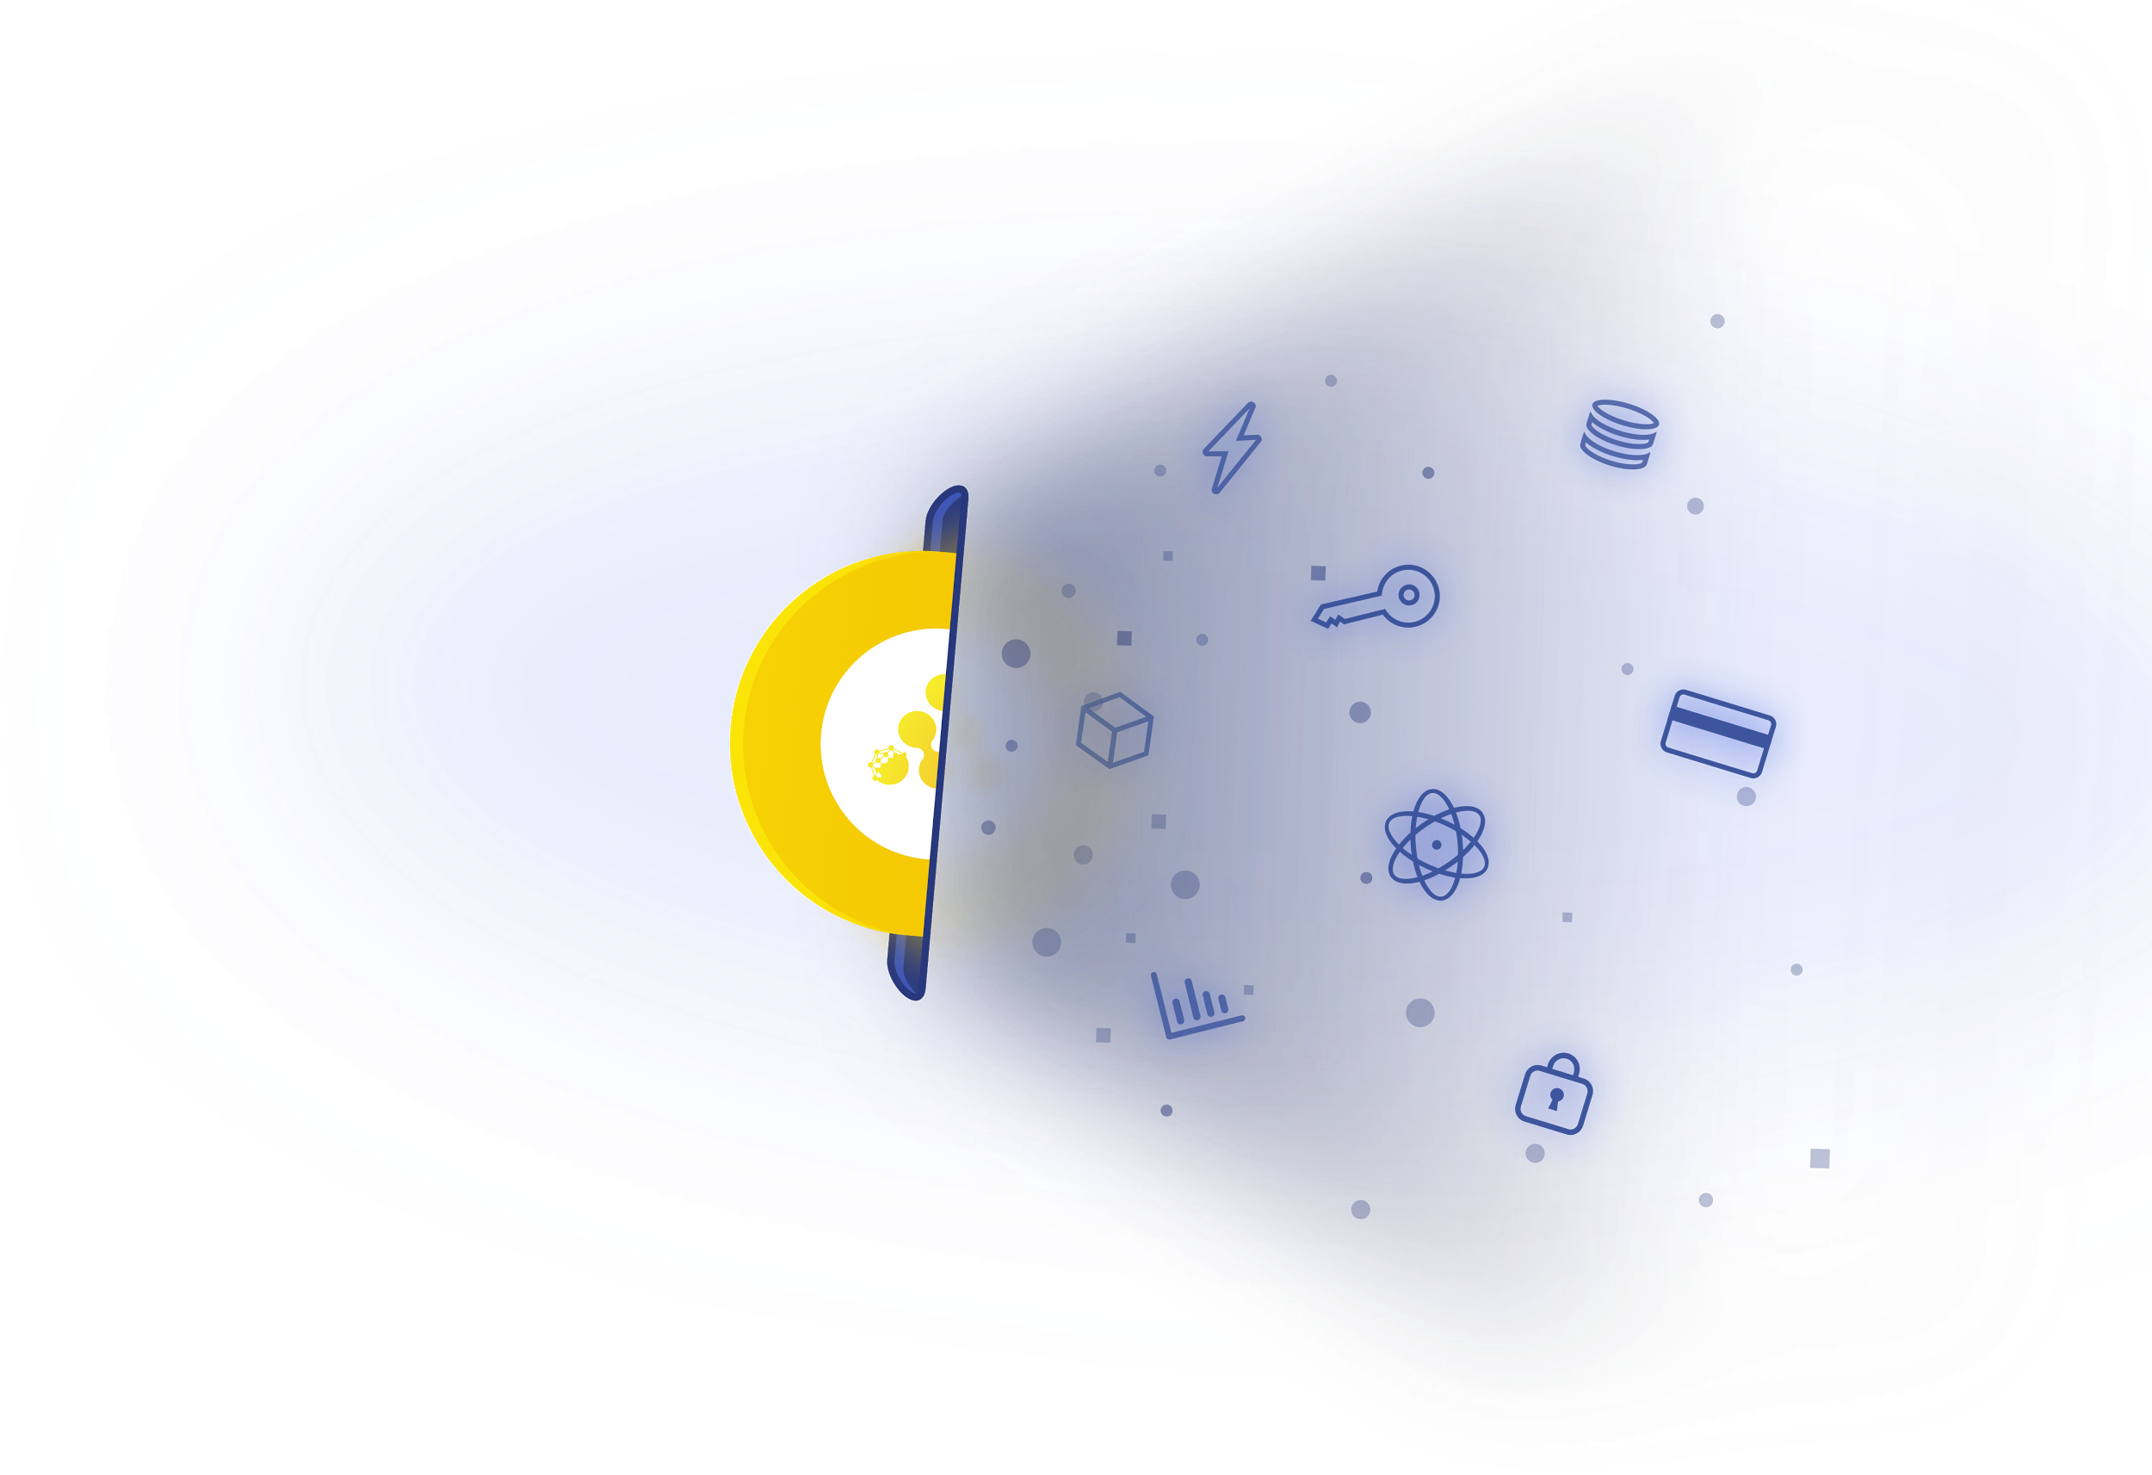
The iExec token: RLC
RLC is an ERC-20 utility token.
RLC is necessary to access the iExec decentralised cloud
Providers are paid with RLC
RLC allows to build incentives in the network
RLC creates a specific market for cloud computing
12

Slide 13
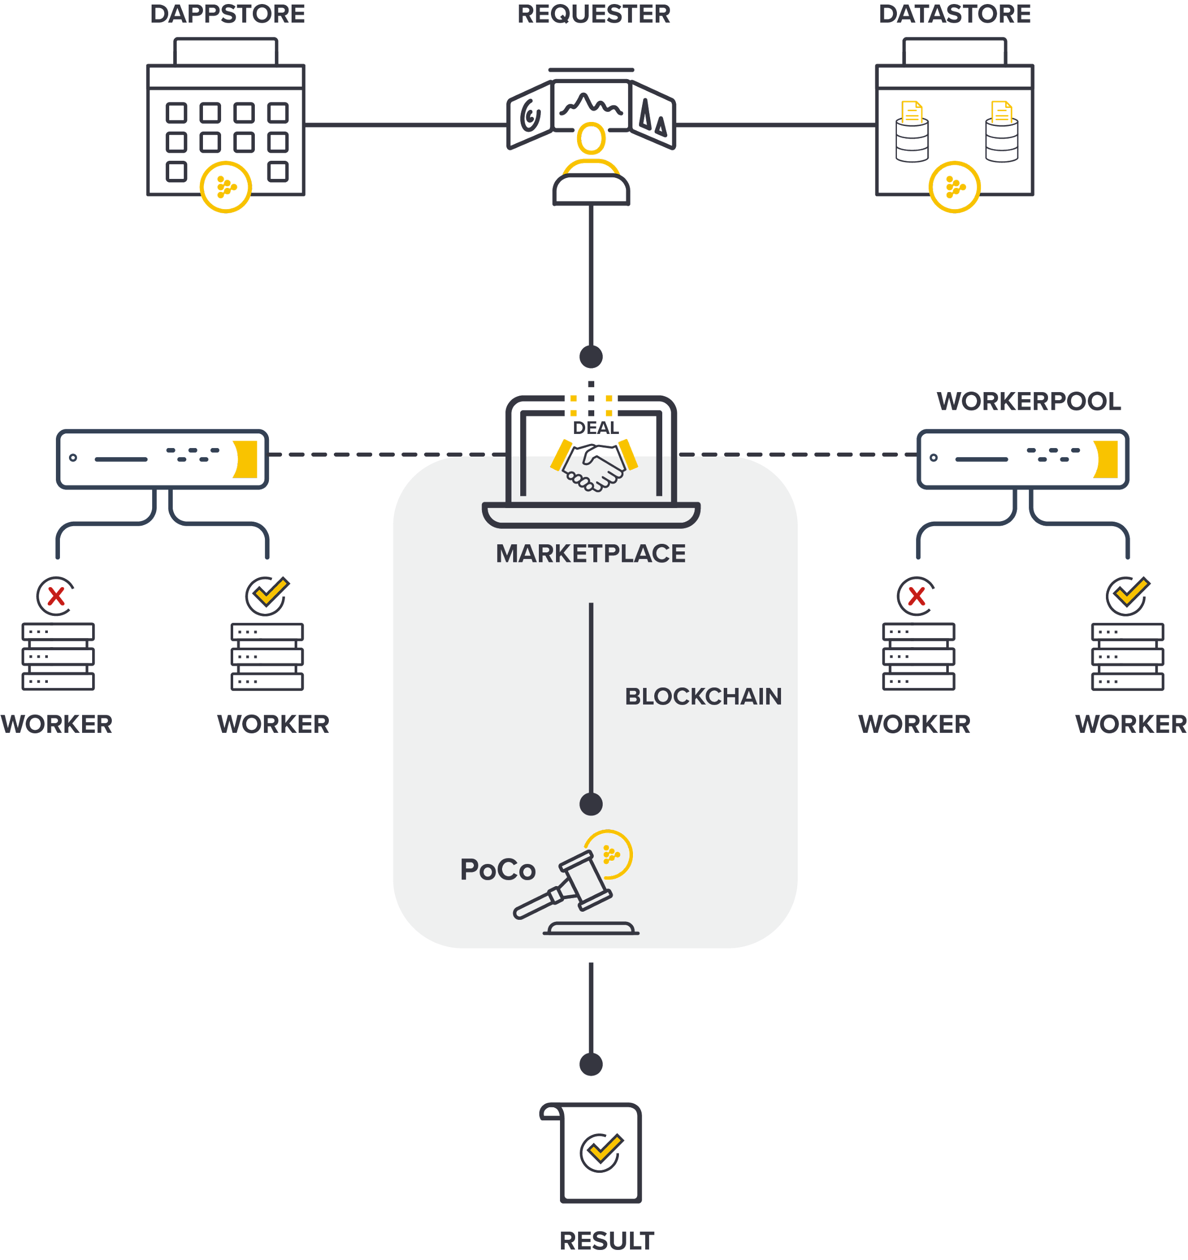
Proof-of-Contribution (PoCo) On-chain validation than an off-chain task was performed correctly
One task = 4 orders, signed off-chain with an Ethereum wallet:
apporder signed by the developer
(datasetorder signed by the dataset provider)
workerpoolorder signed by a worker pool scheduler
requestorder signed by a requester
Orders are matched on-chain: poco.matchOrders() (Check signatures, parameters, balances, …)
PoCo seals a deal & workers start computing
Workers send result hash back to PoCo
PoCo compares results, manages reputation, triggers payments.
<numéro>

Slide 14
Confidential Computing Two types of tasks, with configurable confidence and privacy
Standard tasks
Run on untrusted resources, delegate trust to the blockchain
Replication level depending on desired confidence
Decentralized consensus
On-chain reputation
Staking & economic incentives
Deterministic
TEE tasks
Run isolated within an Intel SGX TEE (Trusted Execution Environments)
+
End-to-end encryption of data & result
Enclave attestation proves that the task was run in TEE
Result signature with enclave key: no need for replication
Determinism not required
13

Slide 15
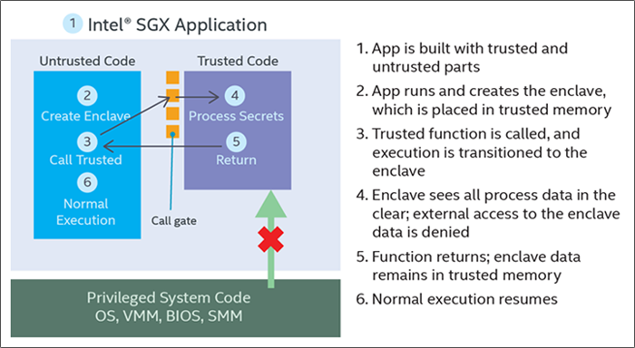
Trusted Execution Environments?
Secure part of a CPU with encrypted memory space
Memory & Code protected from host (even root)
Hardware based security (private key in silico)
Can be remotely attested
(Soon) available on hardware from various vendors
Intel® Software Guard Extensions application execution flow.
<numéro>

Slide 16

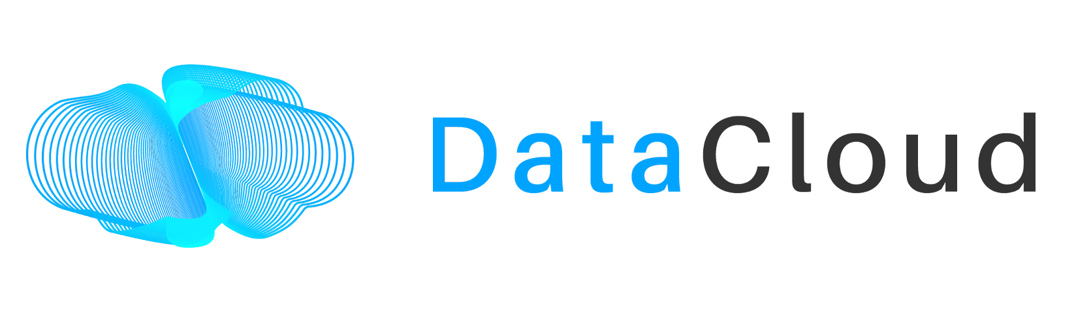
iExec Research Projects
H2020 ONTOCHAIN
H2020 DATACLOUD
ANR RedChainLab
Building an ecosystem for trustworthy content handling & information exchange
Enabling the Big Data Pipeline Lifecycle on the Computing Continuum
Scalable, trusted and privacy preserving decentralized marketplaces
Joint laboratory between the DRIM research team (LIRIS, CNRS) and iExec
Keywords: Semantic Web, Oracles, Decentralized Identities, integration, applications
Keywords: Fog/Edge Computing, Big Data pipelines, self-* cloud computing, Industry 4.0
Keywords: blockchain, decentralized cloud computing, edge computing, security, TEE, Federated Learning
2020−2023
2021−2024
2021−2024
<numéro>

Slide 17
Try us!
Join us!
https://developers.iex.ec/
https://iex.ec/grants/
https://iexec.flatchr.io/
Anthony Simonet-Boulogne anthony@iex.ec

